Slide 1
Neural networks primer
Jesse + Eva

Slide 2

Well… I guess this lecture is kinda obligatory
Goals
What is a Hopfield network?
What are artificial networks? How do they relate to other methods?
How do artificial networks learn?
Learn a tiny bit of pytorch.

Slide 3
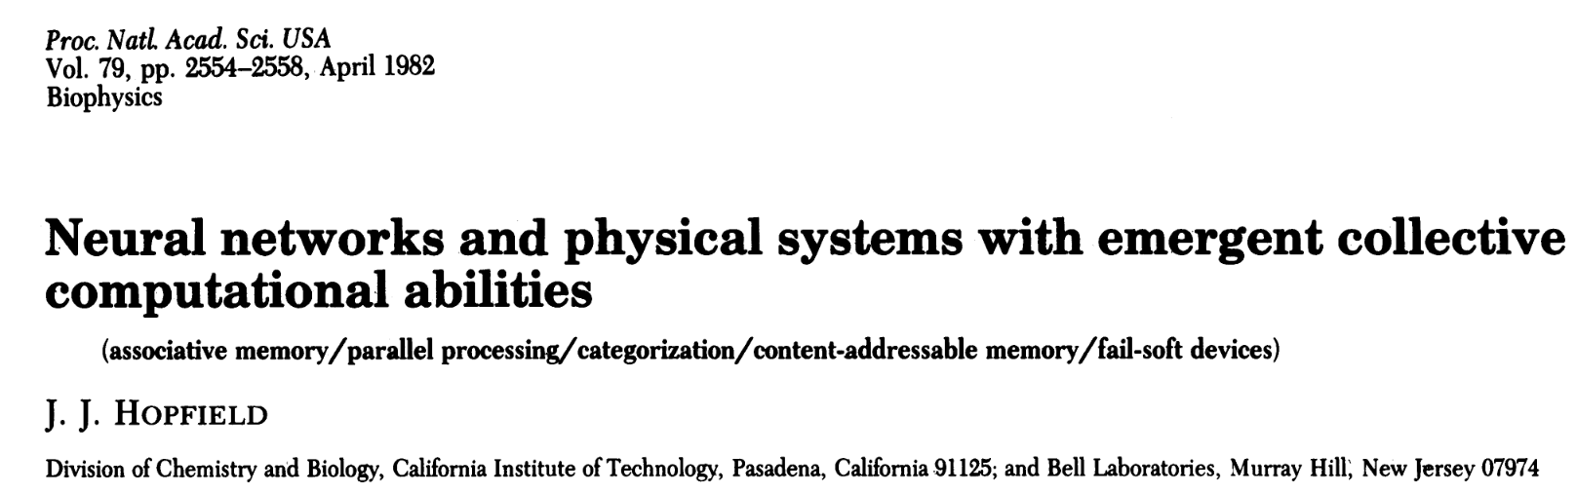

Slide 4
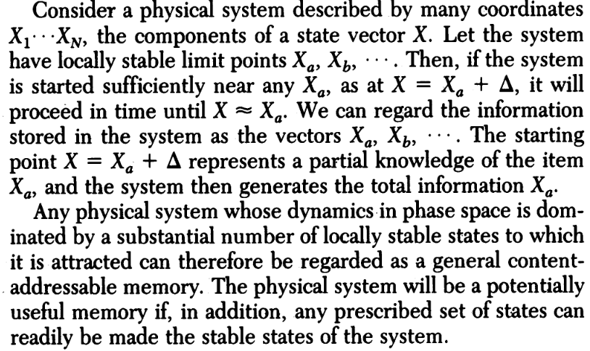
Computations as useful representations of variables
Ask questions!
Never skip over concepts in a paper you don’t understand, stop and confirm your understanding before moving on.
Our state vector X can be the activity of N “neurons”
J. J. Hopfield, 1982

Slide 5

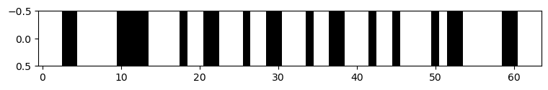
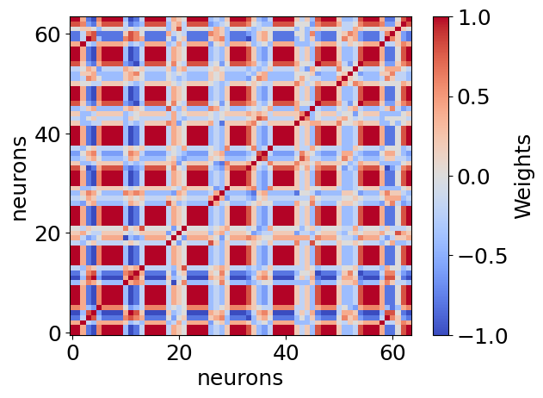
Let’s setup a simple “retina”
Imagine we have an animal that sees everything in 8x8 pixels. Each neuron in its retina responds one-to-one with a given pixel, so we have 64 neurons.
V_{N}:
These neurons each have connections to each other; they are fully connected. We’ll call this matrix T_{ij} where i and j refer to the weight from neuron i onto neuron j.
T_{ij} has shape 64x64
T_{ij}:

Slide 6
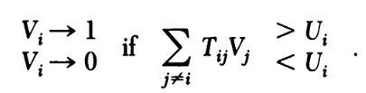

Hopfield networks - storing patterns
How do we build T_{ij}? Can it store “memories?”
U_{i} generally = 0
Storing a set of states V^{s}
But set T_{ii} to 0
Neurons that fire together wire together. What does this mean in terms of the above learning rule?

Slide 7
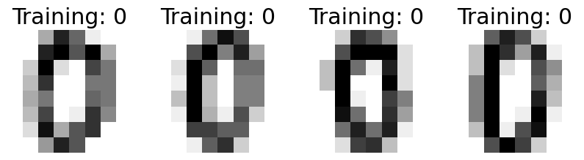
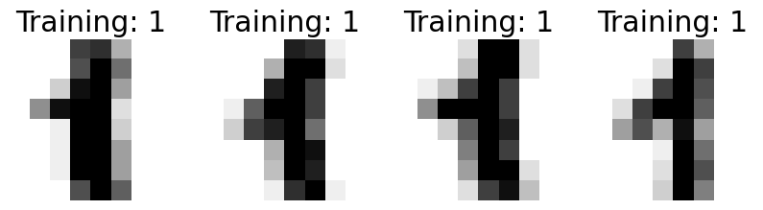


Slide 8

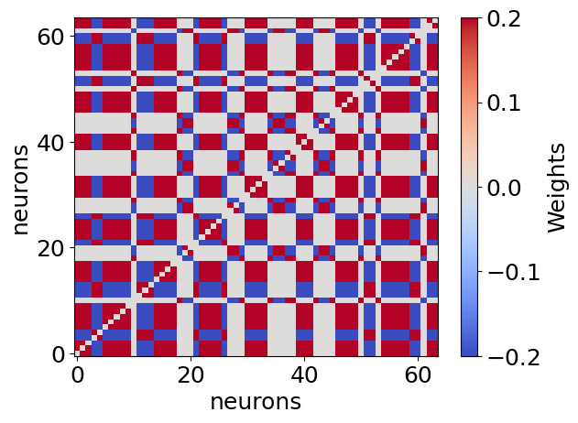
?

Slide 9
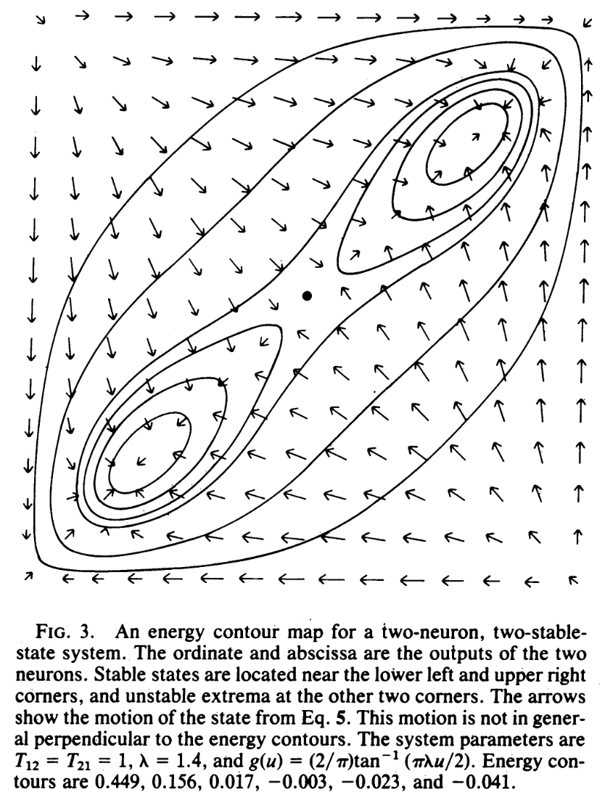
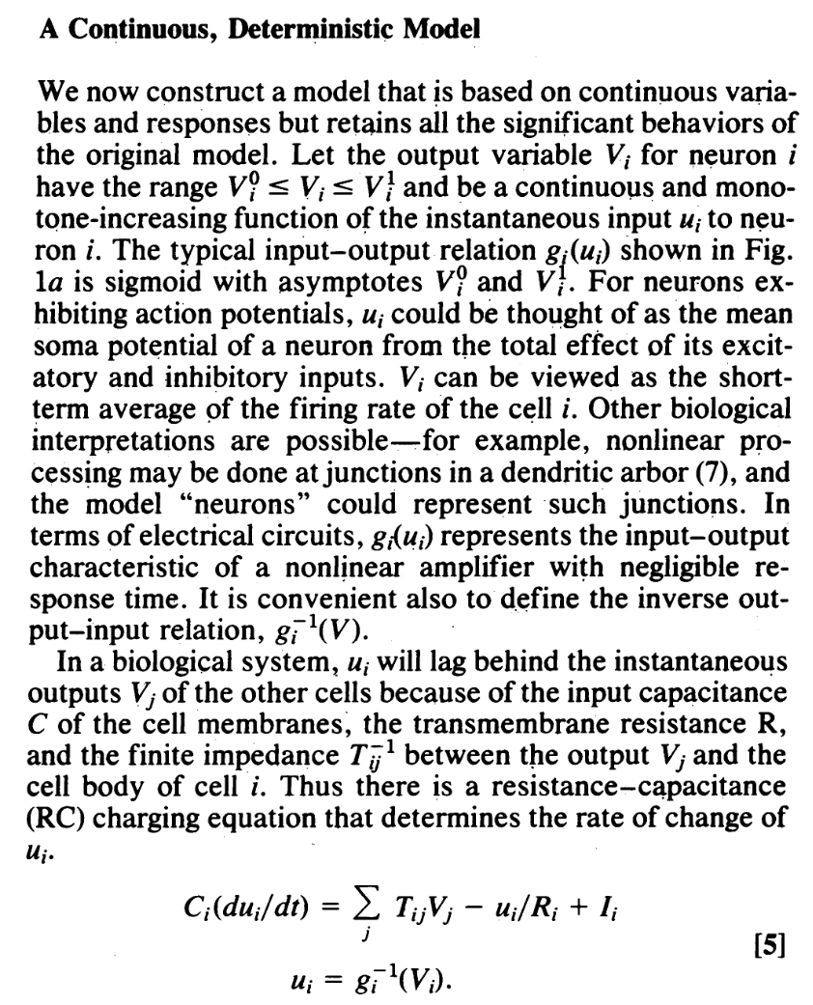
Continuous values?
For example
V_{i} = tanh(u_{i})
J. J. Hopfield, 1984

Slide 10
Switch to the notebook here

Slide 11
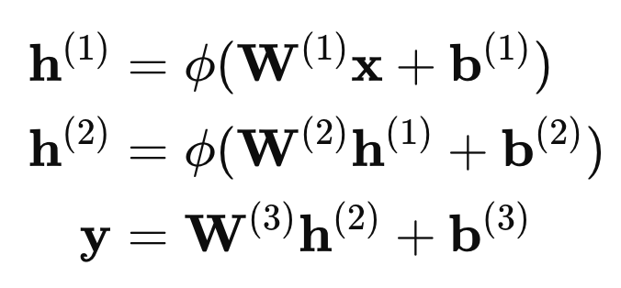
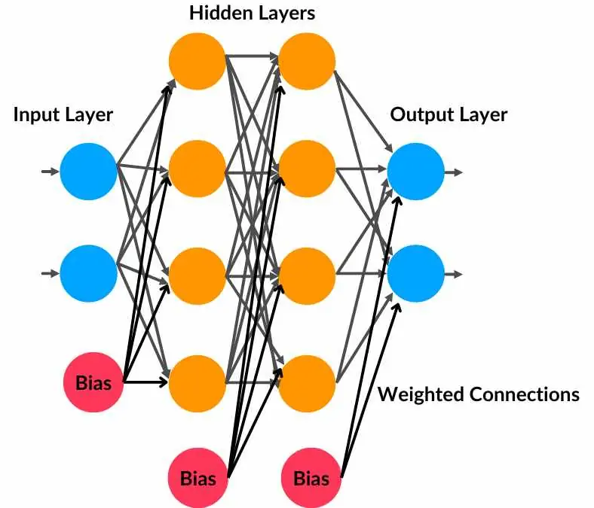
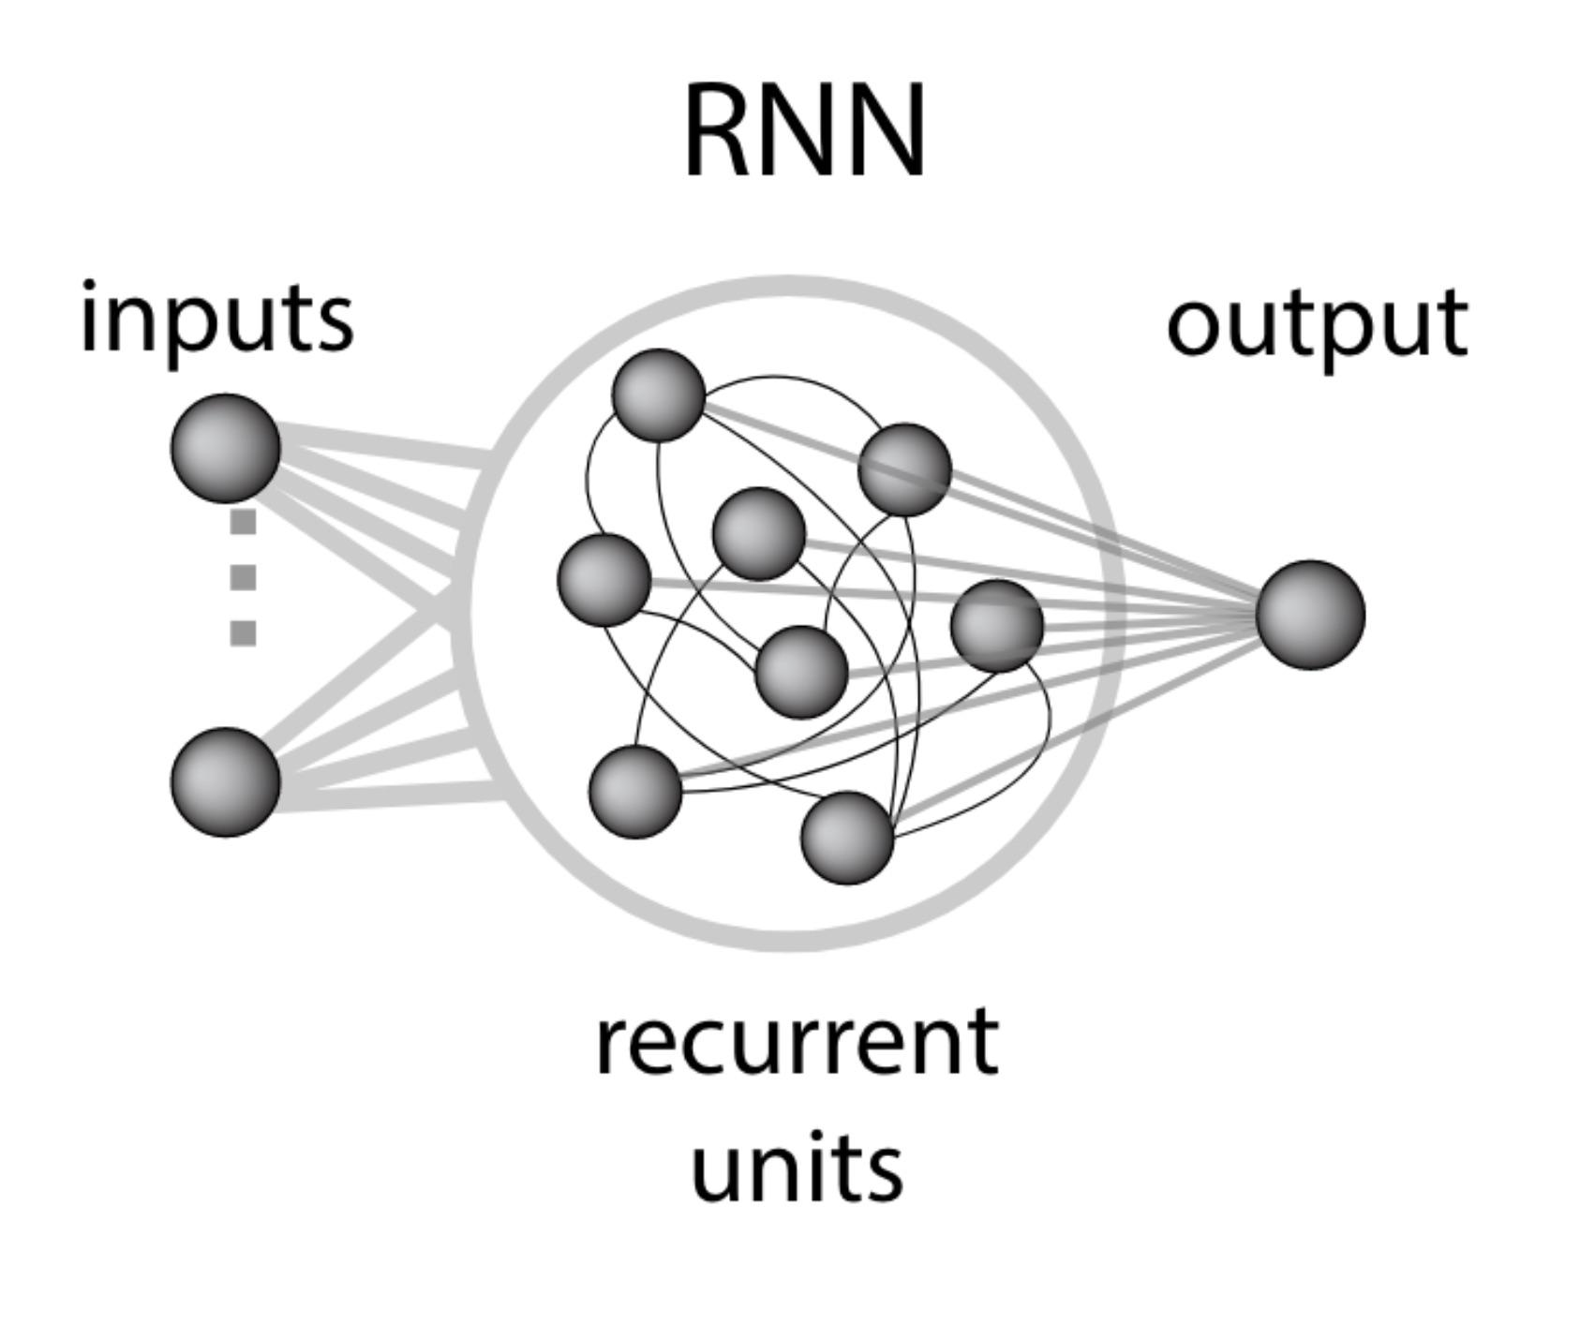
RNNs
MLP
dV = F(W_{rec}V + W_{in}u) + b
For T timesteps
V_{t} = V_{t-1} + [F(W_{rec}V_{t-1} + W_{in}u_{t}) + b] * dt
Output_{t} = W_{out}V_{t} + b
Learn W_{in}, W_{rec}, W_{out}, bias terms
Can have more hidden layers this way!
Beiran et al. 2023
An example of a 3-layer MLP network.

Slide 12
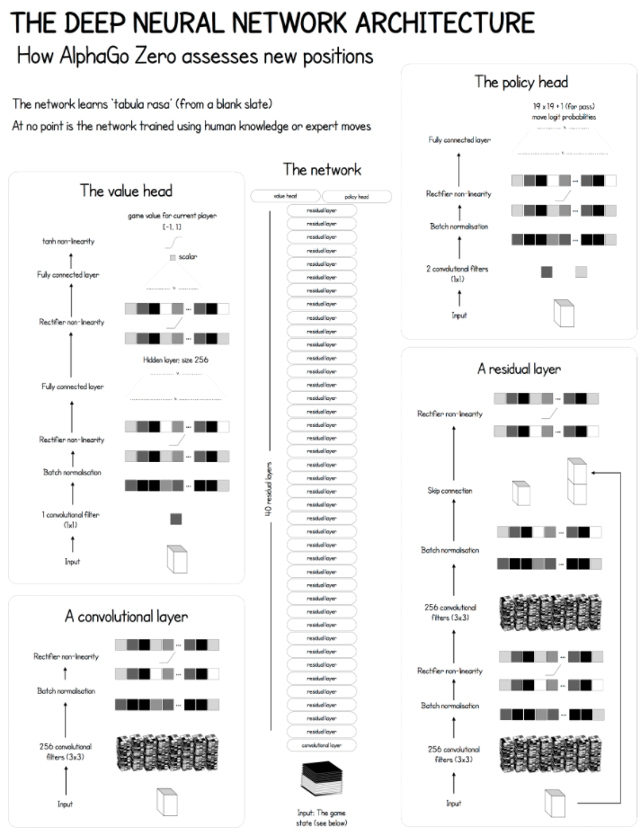
Neural networks can be very powerful learning tools when you stack a lot on top of each other (and add in some domain knowledge).
But are they useful for understanding the brain?
The architecture on the right beat Lee Sodol (one of the best go players ever) at go. But it had trained on ~2000 times as many games. Moreover, how would it fare on a differently shaped board?
Do the computations in ANNs resemble those in Lee Sodol’s brain? Could we use them even if they don’t?
Medium article; Silver, et al., 2017

Slide 13
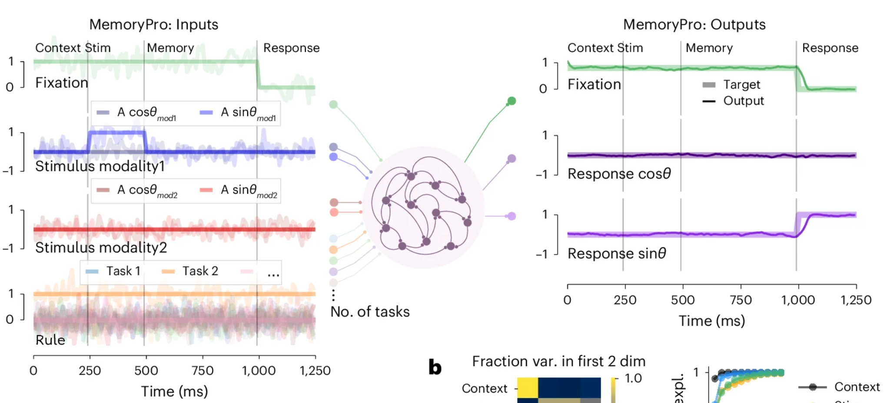
RNNs as neural circuit analog
(Yang et al., 2019; Driscoll et al., 2024, Fig 1a below)
Task: view briefly a target cue, maintain its location in working memory during delay, and saccade toward the remembered location.
…then analyze representations & dynamics of the network

Slide 14
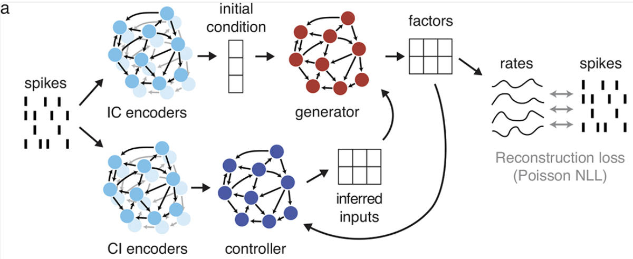
RNNs to analyze neural data (e.g. LFADS)
…then analyze representations & dynamics of the factors
Keshtkaran, et al., (2023); Pandarinath, et al., (2018)

Slide 15
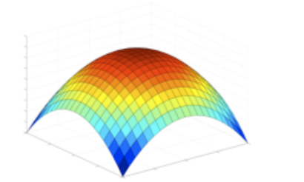
How do we train neural networks?
Not going to go into too much detail (you can learn plenty more about this depending what classes you choose to take), but core to understanding neural networks is the concept of a gradient.
Recall from the GLM lecture, we used scipy.optimize.minimize to find the coefficients that best explain the spiking data. In other words, we found the best options for our parameters by maximizing the likelihood of the spikes given those parameters. For few parameters, you could imagine a “parameter space” over which likelihood is a function. The derivative of this function would be the “gradient.”
Put simply, the gradient refers to how small changes in a set of parameters change a corresponding function that depends on them.

Slide 16
Training neural networks
The goal is then to follow the gradient over all weights in a neural network until you find the maximum with respect to a “loss function” that essentially describes how well your neural network does. If a RNN is being trained to describe spiking activity, this loss function might still be a Poisson likelihood!
It turns out that there is a rather efficient and elegant algorithm for computing these gradients across layers of an MLP called backpropagation, so called because it “propagates” the loss function iteratively “back” across layers until we take a full step in the right direction according to the gradient.
See 3Blue1Brown’s excellent primer if you want more details, but tldr it’s just the chain rule from calculus.

Slide 17
A brief note on automatic differentiation
These days, most neural network libraries use automatic differentiation to track gradients, rather than explicitly perform backpropagation over neural network architectures.
You definitely don’t need to know any of this for your classes, but I think it’s cool.
Consider that a gradient is the derivative of a function w.r.t. some parameters. If the function is f(x)=2x then x’s gradient is 2. If the function is a massive neural network, the gradient is a huge matrix with very complex structure.
The key insight that led to automatic differentiation is that anything a computer does (for example running a neural network) is ultimately represented in simple algebraic operations on pieces of computer memory. Gradients can be tracked through these simple operations, and the chain rule applied to get a gradient for any arbitrary function over its inputs. Even if that function is my 10000 lines of garbage.

